Slide 1
Image Classification Using Cifar 10 Dataset
Done By :-
Veerendra
6th Sem AI&ML
BGSCET

Slide 2
ML Model Used and Rationale
Model Used: Convolutional Neural Network (CNN)
Why CNN?
Convolutional Neural Networks (CNNs) are highly effective for image classification tasks due to their ability to automatically extract and learn important features such as edges, textures, and shapes. Unlike traditional neural networks, CNNs utilize convolutional layers that detect spatial hierarchies, ensuring better pattern recognition. The use of shared filters reduces the number of parameters, making CNNs computationally efficient and less prone to overfitting. Additionally, pooling layers provide translation invariance, allowing the model to recognize objects regardless of their position in an image.
Framework Used: TensorFlow/Keras

Slide 3
Model Parameters
Model Training:
Convolutional layers with Relu activation
MaxPooling layers for dimensionality reduction
Fully connected layers with softmax activation
Hyperparameters:
Number of Epochs: 50
Optimizer: Adam
Loss: Categorical Crossentropy

Slide 4
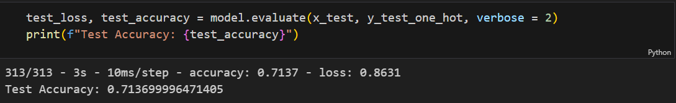
Loss Function
Loss Function Used: Categorical Crossentropy
Suitable for multi-class classification
Measures difference between predicted & actual probabilities
Helps in optimizing model weights through backpropagation

Slide 5
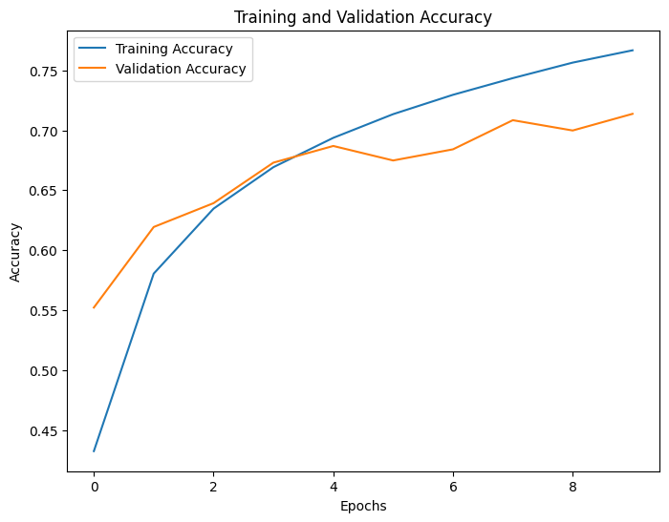
Test accuracy and a loss function convergence graph
Test Accuracy: 71%
Graph Representation: Training & Validation Accuracy

Slide 6
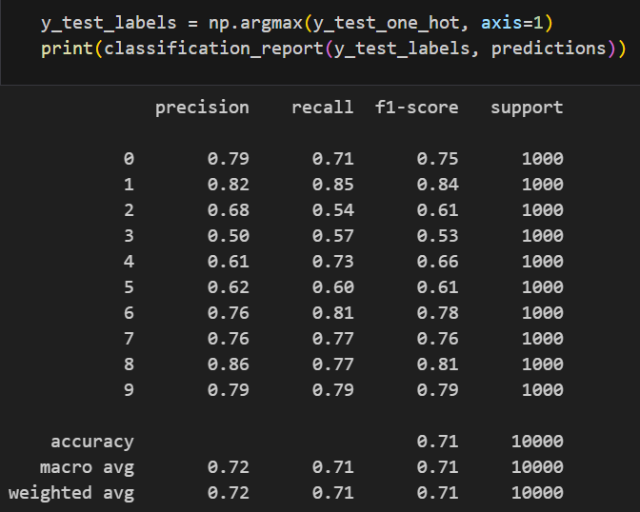
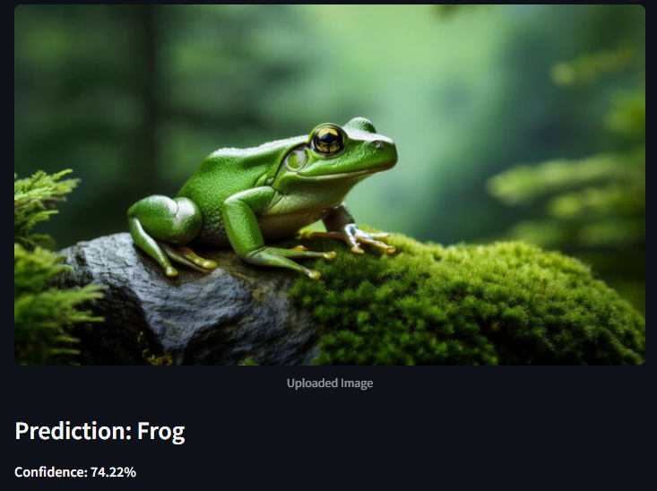
Final reflections or observations
Classification Report
Prediction
Limitations of Image Classification Using CIFAR-10 Dataset
Low Image Resolution – CIFAR-10 images are only 32×32 pixels, making it difficult to capture fine details in complex objects.
Limited Number of Classes – The dataset contains only 10 classes, restricting its use for real-world large-scale applications.
Not Suitable for Advanced Tasks – CIFAR-10 is too small for applications like object detection, segmentation, or fine-grained classification.

